Slide 1
Capstone Project 3
Sentiment Analysis : Predicting Sentiment of COVID19 Tweets
Team Members :
Abhishek Kumar Hritik Saini

Slide 2
Contents
Problem Statement
Data Summary
Missing Values
Exploratory Data Analysis
Feature Engineering
Model Training
Conclusion

Slide 3
Problem Statement
There is lot of misuse of social media platform, in which Twitter is one of them. Many user intentionally send negative tweets to create fear and negativity in the society or environment.
Our objective is to build a machine learning model to predict the sentiment of COVID-19 tweets. If tweets had been found negative then tweets would be removed from twitter.

Slide 4
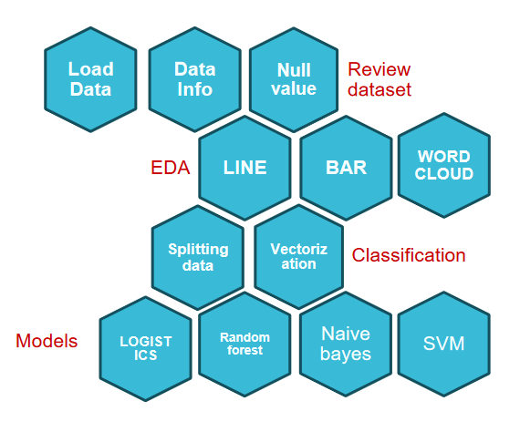
Data Pipelines

Slide 5
Libraries
1. NumPy 2. Panda 3. Matplotlib 4. Seaborn 5. Datetime 6. Sklearn 7. NLP

Slide 6
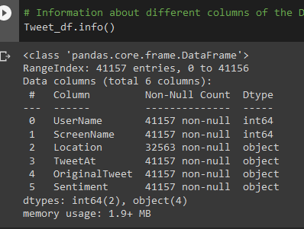
Data Summary
We were provided with Coronavirus_Tweets.csv dataset.
Shape of the dataset is (41157 row,6 columns).
Important features of dataset are-
1) Username
2) Screen Name
3) Tweet at
4) Location
5) Original Tweet
6) Sentiment

Slide 7
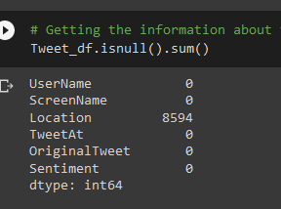
Looking for Missing Values
On looking the dataset we found that feature ‘Location’ has missing values(8594).
We don’t have any idea about that tweets whose location is missing.
So we have ap option to fill that missing values by Mode or another way is to fill randomly.
Also, one way is to drop those columns to get rid off missing values.

Slide 8
EXPLORATORY DATA ANALYSIS

Slide 9
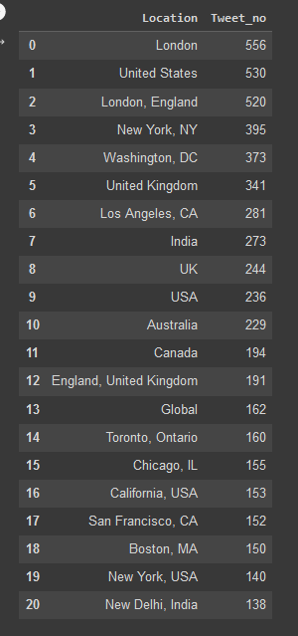
Tweets from top 20 location
This table clearly shows that London is the location from which maximum number of tweet are posted and New Delhi, India is a location from the top 20 location being at the lowest position

Slide 10
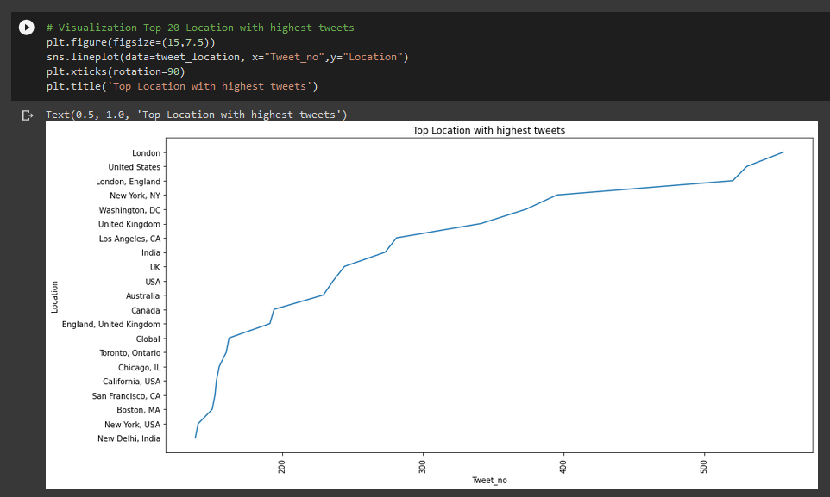
Visualization

Slide 11
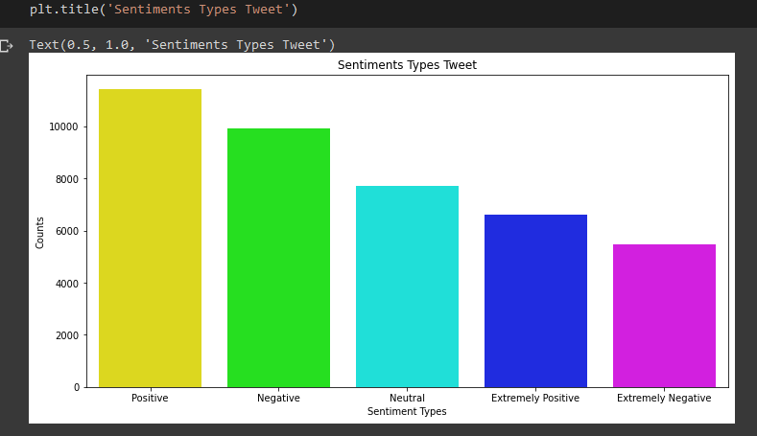
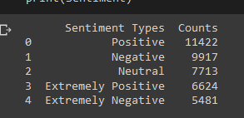
Exploring the Sentiment Column
This Data clearly shows that positive it the maximum sentiment tweet made in all the locations:

Slide 12
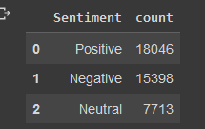
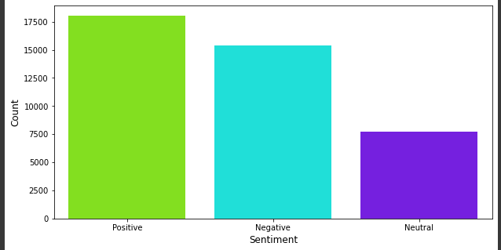
There are 5 subcategories in this case, so we will combine 5-class classification problem into a 3-class classification problem by replace Extremely Positive tweets with positive tweets and Extremely Negative tweets with negative tweets.

Slide 13
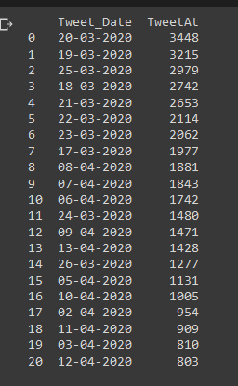
Top dates with maximum number of tweets
The table and the graph shows the top dates of the year with the maximum no of tweet.20/03/2022 is the date where maximum number of Tweet was made followed by 19/03/2022.

Slide 14
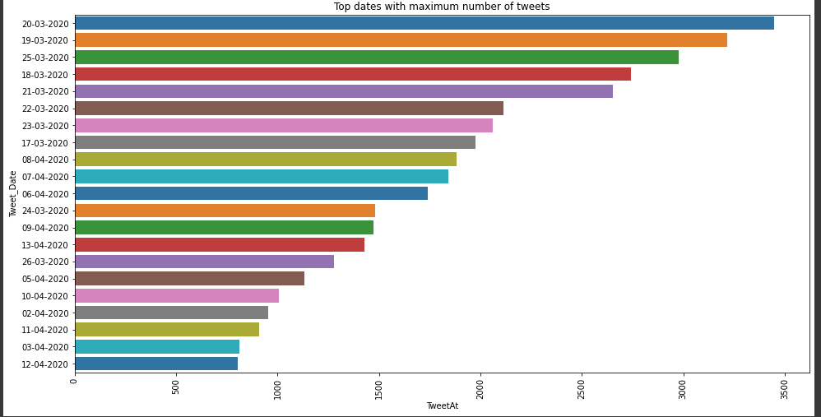

Slide 15
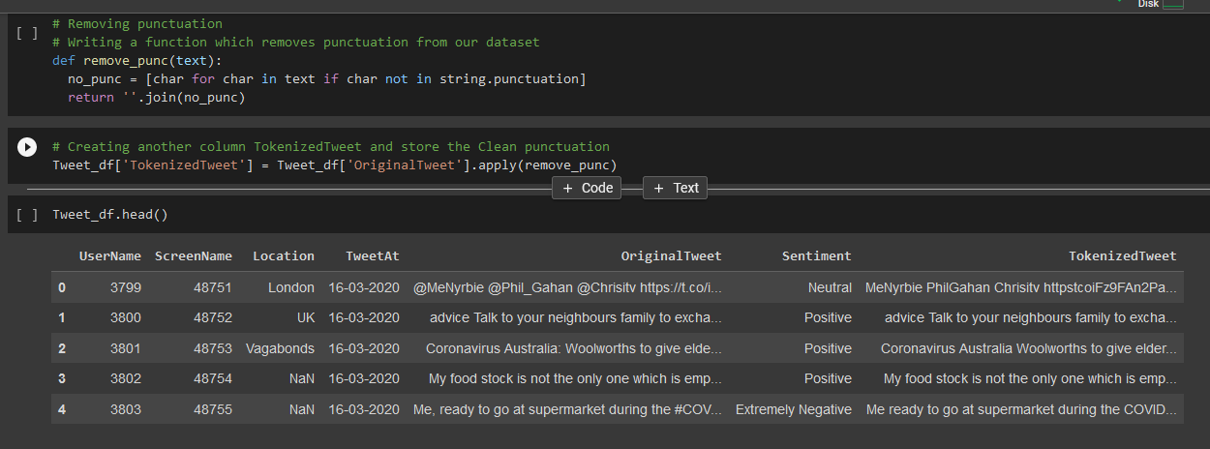
Data Pre-Processing
Removing Punctuation

Slide 16
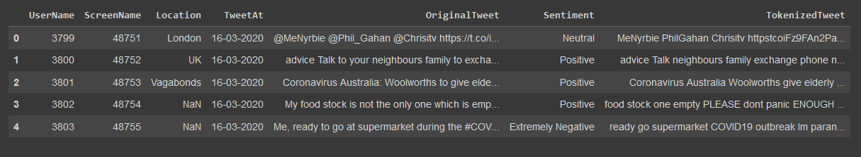
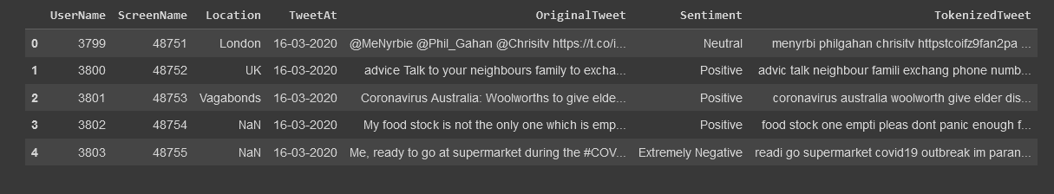
Removing Stop words and Stemming

Slide 17

Word Cloud
After removing punctuation, stop words and using stemming to words cropped to save space from the tweets we want to know which words are mostly used by the people

Slide 18
Building Classification Models
We will be using tf-idf method for vectorising the text. Then, we will implement 4 models: * Logistic Regression * Random Forest Classifier *Naive Bayes Classifier *Support Vector Machine(SVM) We will determine which model has the highest accuracy score before selecting it for model building

Slide 19
Splitting the data set
Independent Variable- TokenizedTweet
Dependent Variable- Sentiment
X_train - (32925) X_test - (32925) y_train - (8232) y_train - (8232)

Slide 20
Vectorization
Creating an object of TfidfVectorizer, the test data was normalised, and stored in the variables X_test and X_train, and also both predicting actual and predicted values.
X_train= (32925, 63453) X_test= (8232, 63453) Y_train= (32925) Y_test= (8232)

Slide 21
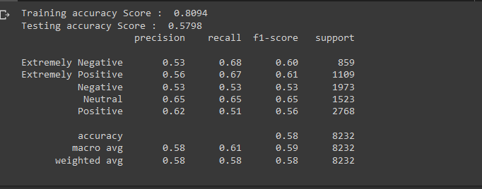
Implementing Logistic Regression

Slide 22
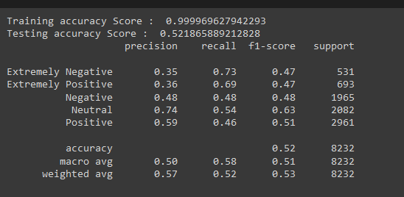
Implementing Random Forest Regression

Slide 23
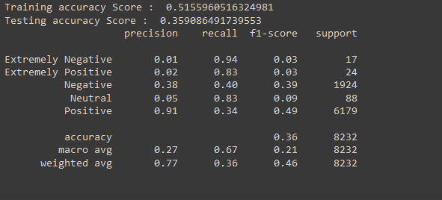
Implementing Naïve Bayes Regression

Slide 24
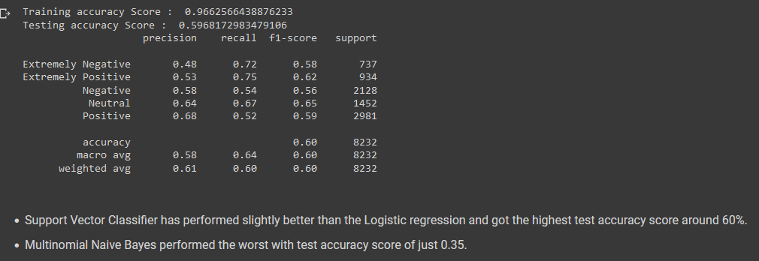
Implementing Support Vector Machine(SVM)

Slide 25
Conclusions
The majority of the tweets were around 250 characters long, indicating that there was a lot of interest in COVID-19 among the general public.
More positive tweets than neutral or negative ones were tweeted globally.
People tweeted more in March than in April since many nations imposed lockdown during this time.
The United States and London (England) were the two locations with the most tweets.
We saw inconsistent responses from Australia during the pandemic, with nearly equal numbers of positive and negative tweets.
Words like COVID19, grocery, supermarket, shop, price, etc. are frequently used in tweets, indicating that throughout the pandemic, individuals were mostly concerned about food supply and their costs.
Support Vector Classifier has performed slightly better than the Logistic regression and got the highest test accuracy score around 60%.
Multinomial Naive Bayes performed the worst with test accuracy score of just 0.35.

Slide 26
THANK YOU

